Slide 1
Updates on Urothelial Neoplasms
Manju Aron MD
Keck School of Medicine
University of Southern California, USA

Slide 2
Disclosure of Relevant Financial Relationships
Dr. Manju Aron declares she has no conflict(s) of interest to disclose

Slide 3
Objectives
Describe some of the pertinent changes in the WHO 5th edition
Changes in nomenclature
Addition/deletion of entities
Discuss the current status of grading pTa tumors
Recognize some of the new subtypes of invasive urothelial carcinoma
Discuss briefly the substaging of pT1 tumors
Examine the current status of molecular classification of bladder carcinoma
Notes:
By the end of this presentation

Slide 4
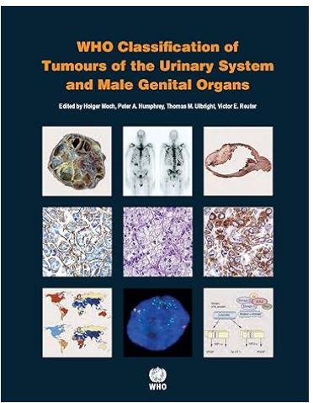
Non-invasive urothelial neoplasms
Urothelial dysplasia Urothelial carcinoma in situ Urothelial proliferation of unknown malignant potential Urothelial papilloma Inverted urothelial papilloma Papillary urothelial neoplasm of low malignant potential Noninvasive papillary urothelial carcinoma, low-grade Noninvasive papillary urothelial carcinoma, high-grade
Urothelial dysplasia Urothelial carcinoma in situ Urothelial proliferation of unknown malignant potential Urothelial papilloma Inverted urothelial papilloma Papillary urothelial neoplasm of low malignant potential Noninvasive papillary urothelial carcinoma, low-grade Noninvasive papillary urothelial carcinoma, high-grade m
Notes:
Dysplasia no longer has a distinct subcategory
UPUMP is no longer part of the lexicon of non-invasive urothelial neoplasms

Slide 5
Dysplasia
Architectural disarray and cytologic atypia that cannot be explained by a reactive process but not enough to call CIS
Notes:
Why dysplasia is no longer a distinct category
Loosey goosey definition, very subjective
Lack of interobserver agreement between even GU pathologists
The clinical significance of this diagnosis is not known
Clinical surveillance; no definite therapy

Slide 6
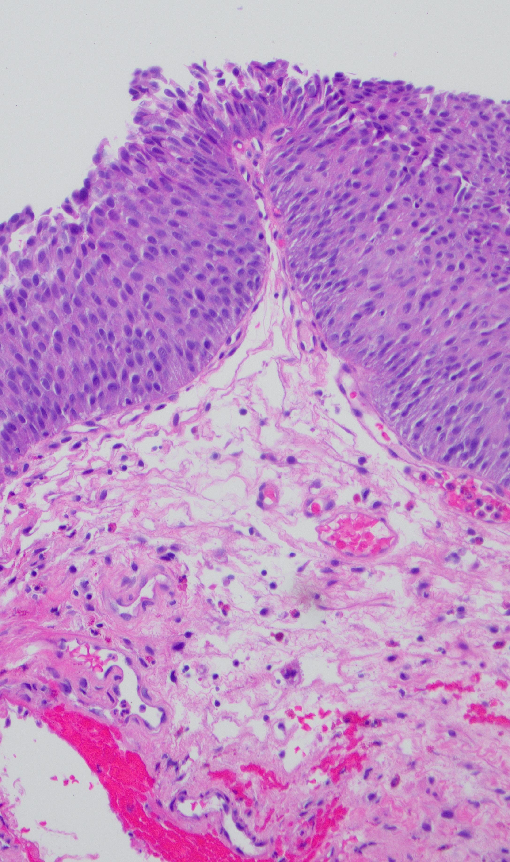
Flat or papillary hyperplasia/urothelial proliferation of unknown malignant potential
Atypical urothelial proliferation- flat/tented
Thickened urothelium, increased cell density, no cytologic atypia, flat or tented without true fibrovascular cores/papillae
Notes:
Subset of flat urothelial hyperplasia: represent shoulder lesions of low-grade urothelial neoplasms
If denovo without h/o papillary tumor, AUP-flat is not as closely related to tented with development of urothelial neoplasia
AUP-flat assoc with pap uroth neoplasia may show similar genetic alteratios involving chr 9, 11, 17.. FGFR3 mutations etc

Slide 7
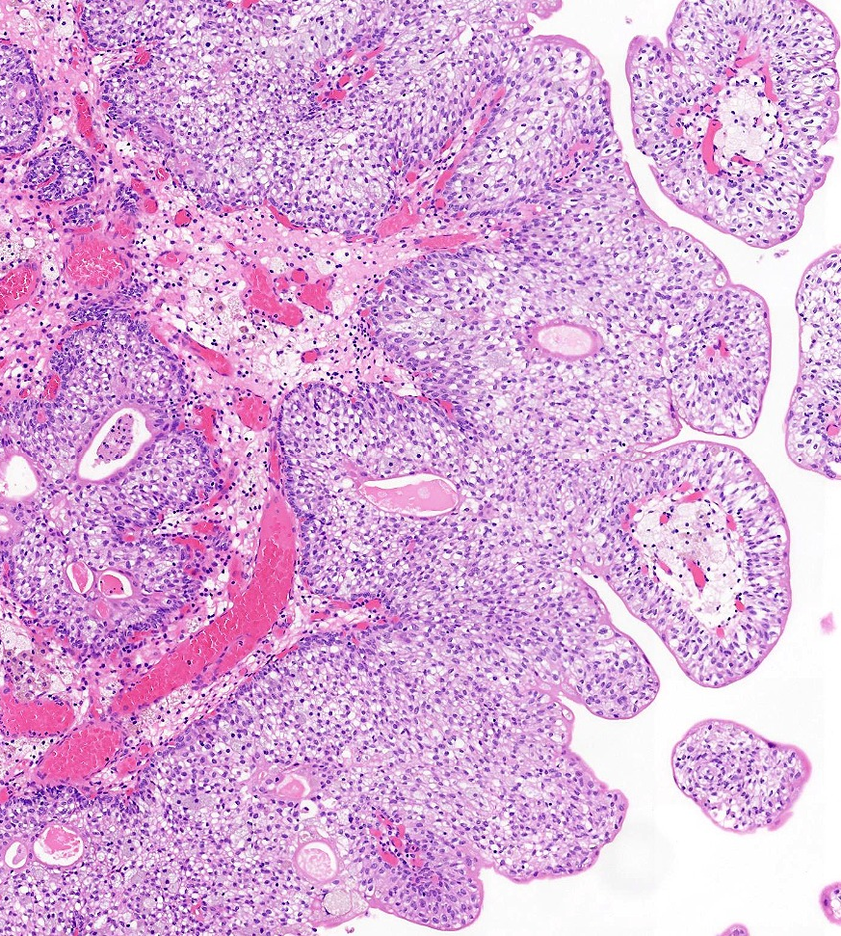
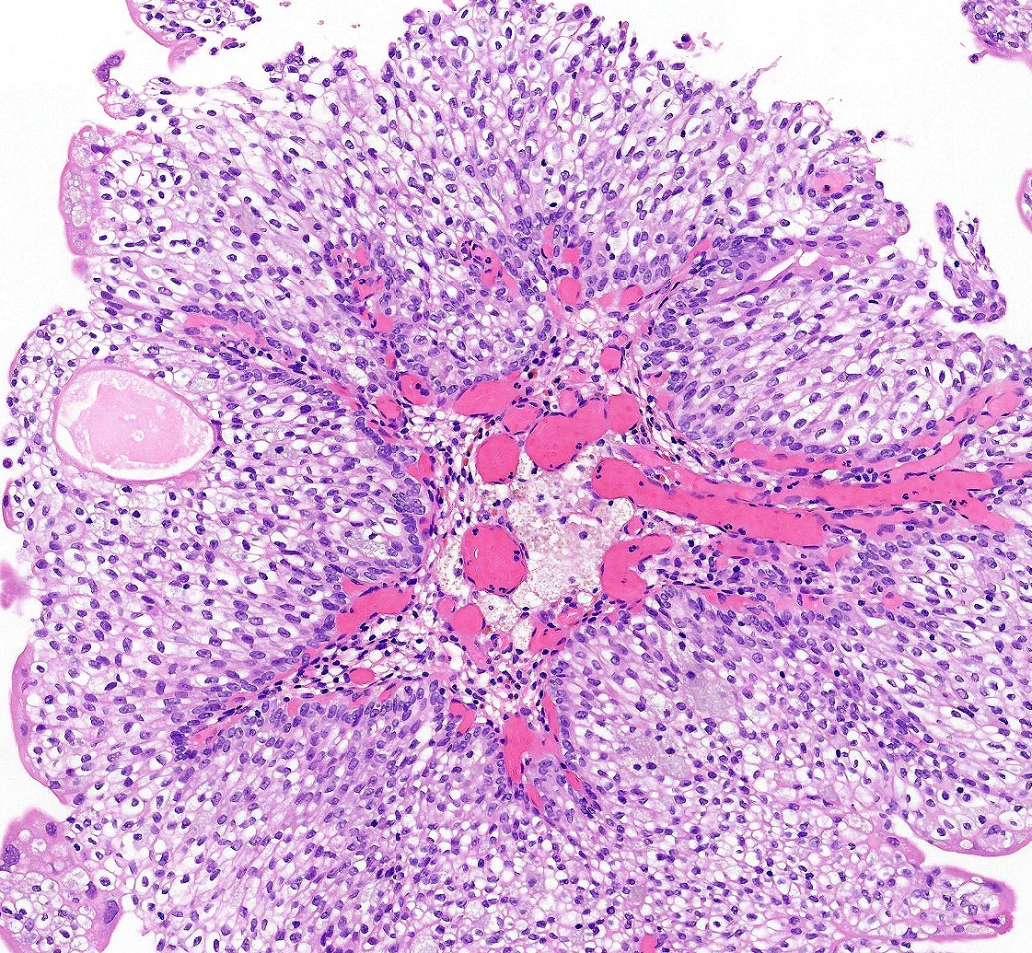
PUNLMP
No h/o urothelial carcinoma
Small & single lesion
Papillae with thickened urothelium
Monotonous with mild cellular and nuclear enlargement
PUNLMP
WHO 5th Edn
Notes:
Very low interobserver reproducibility, because of vague descriptive terms. Majority of folks in the iSUP consensus conference do not diagnose PUNLMP.
I don’t know how to make this diagnosis

Slide 8
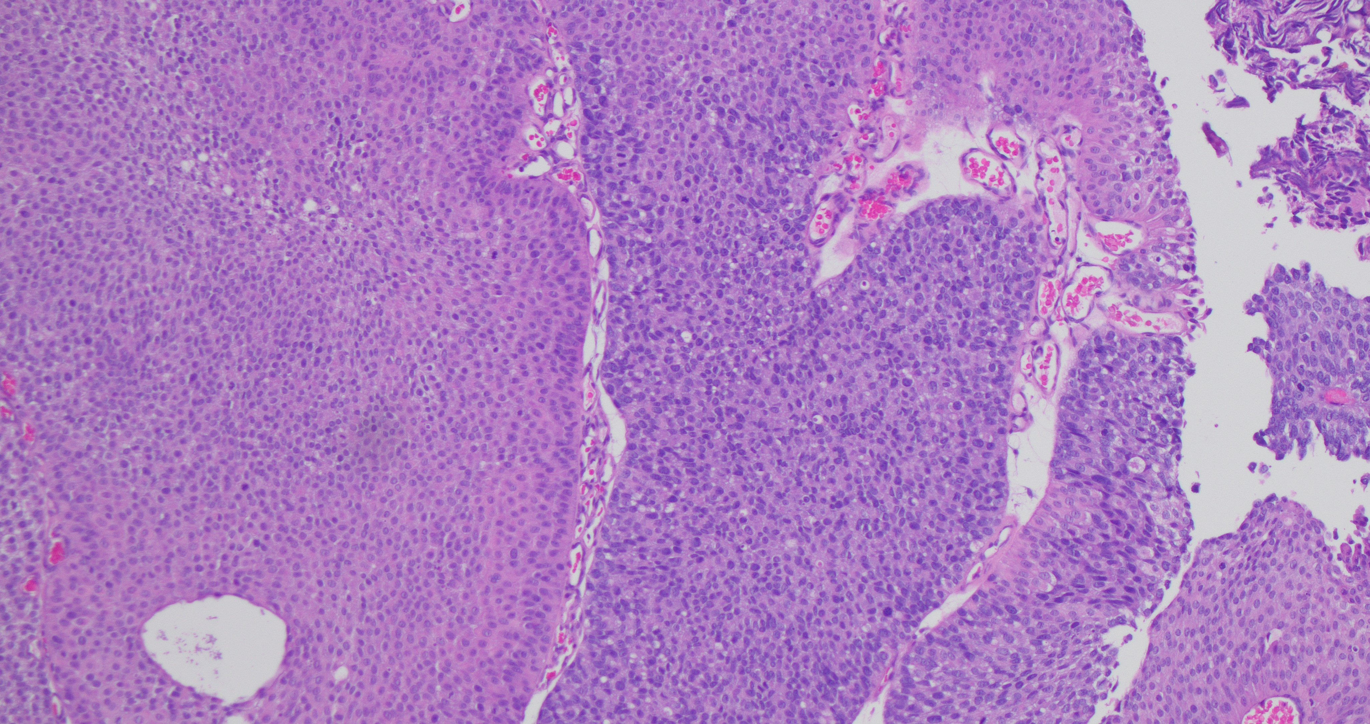
Grade heterogeneity
Low-grade
High-grade
Notes:
Grade heterogeneity has been documented in upto 30% of urothelial tumors
More studies needed for validation
Report the percentage high-grade component in all heterogeneous tumors with <50% HG
One study has shown that in mixed tumors even the low-grade areas show increased MIB-1 and CDKN2A deletion showing molecular changes predating morphologic changes

Slide 9
Grading of pTa
WHO 2022 retains the two-tier system of grading: low and high-grade
Uses arbitrary cut off of >5% high-grade components in mixed grade tumors to call it high-grade
ISUP: No consensus on cut off, but majority (36.9%) used >5% to call a mixed grade tumor as high grade
GUPS: Recommends >10%
Larger studies controlled for other factors influencing outcome needed
Refinement of histologic grading criteria
Potential role of molecular grading ?
Am J Surg Pathol 2024;48:e11–e23
Adv Anat Pathol 2021;28:179–195
Virchows Archiv (2019) 475:445–455
Notes:
Report the percentage high-grade component in all heterogeneous tumors with <50% HG
One study has shown that in mixed tumors even the low-grade areas show increased MIB-1 and CDKN2A deletion showing molecular changes predating morphologic changes
Factors influencing outcome: number, size, focality, presence of CIS, grade and stage of concurrent neoplasms, prior treatment, longer period of follow up
Gofrit et al showed that tumors with <10% high grade treated with IVT behaved like low grade. Reis et al showed that tumors not treated by IVT that had ≤ 5% high-grade showed higher grade progression than low-grade tumors but it was not statistically significant. maybe MG tumors with small component have an intermediate prognosis: worse than LG and better than HG
Regarding refinement of grading: Hybrid grading system has been proposed
In a series of 147 NMIBCa cases was selected, and the tumors were divided into four subgroups based on the presence of CK20 and/or CK5/6, that is, null (CK20-, CK5/6-), mixed (CK20+, CK5/6+), basal (CK20-, CK5/6+), and luminal (CK20+, CK5/6-) categories. Survival analysis was estimated using the Kaplan-Meier method and the log-rank test. Hazard ratios were calculated by Cox multivariate analysis. The molecular grade included cases with null (n = 89), mixed (n = 6), basal (n = 20), and luminal (n = 32) phenotypes with differences in recurrence-free, progression-free and cancer-specific survival associated with molecular-grade categories in patients with low- or high-grade Ta, or high-grade T1 tumors. The multivariate analysis identified the luminal phenotype as a predictor of more aggressive neoplasms.

Slide 10
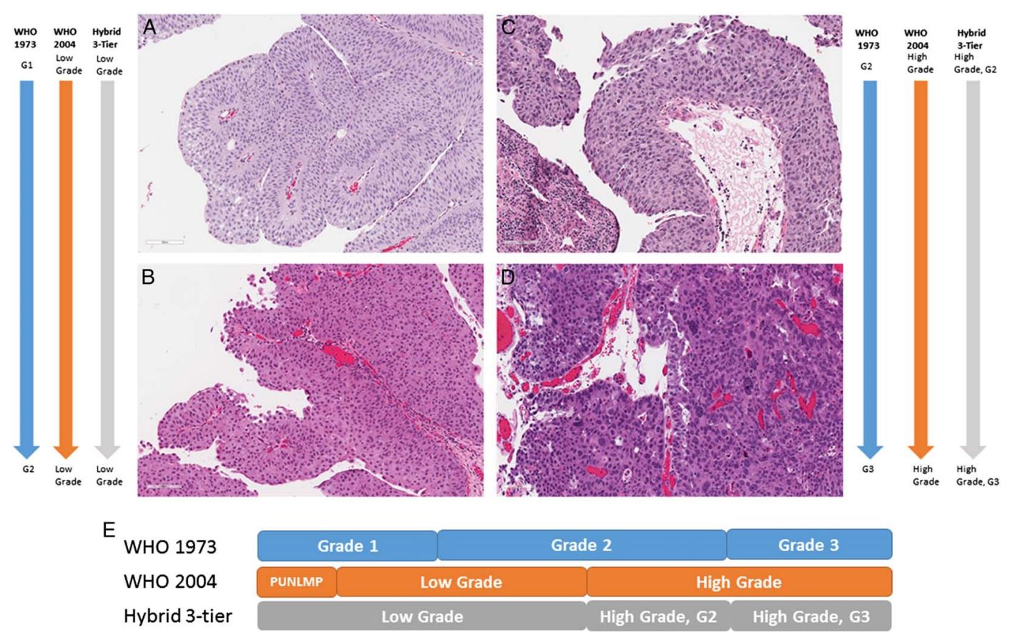
Defining histological criteria
Am J Surg Pathol 2024;48:e1–e10
Notes:
Neither the WHO 1973 or the 2004 grading systems are perfect. So, there was a proposal to opt for a hybrid 3-tier system, which puts PUNLMP and Low-grade into one category, and divides the high-grade categories into G2 and G3 with G3 of the hybrid equivalent to G3 of the WHO 1973 grading system. This has been embraced by 88.7% of the polled ISUP members; with 40% agreeing to move to in the future, once they get comfortable with the histologic criteria
Both 1973 and 2024 grading systems are prognostic for tumor progression but not recurrence

Slide 11
5-Year Disease Progression Rate
WHO 1973 | WHO 2004 | Hybrid
Grade 1: 2.8 % | Low Grade: 3.2% | Low Grade: 3.2%
Grade 2: 14.7% | High grade: 35.8% | High grade G2: 27%
Grade 3: 44% |  | High Grade G3: 44%
Am J Surg Pathol 2024;48:e1–e10
Notes:
Dusease p[rogression defined as greater than or equal to pT2

Slide 12
Morphological Subtypes
Variable morphologies are identified in upto 25% of invasive carcinomas
Percentage should be reported; there is no cut-off
WHO 2022 recommends that all subtypes and divergent differentiation should be considered high-grade
Eur Urol Focus. 2022 Mar;8(2):457-464
WHO classification of tumors series 5th ed;vol 8

Slide 13
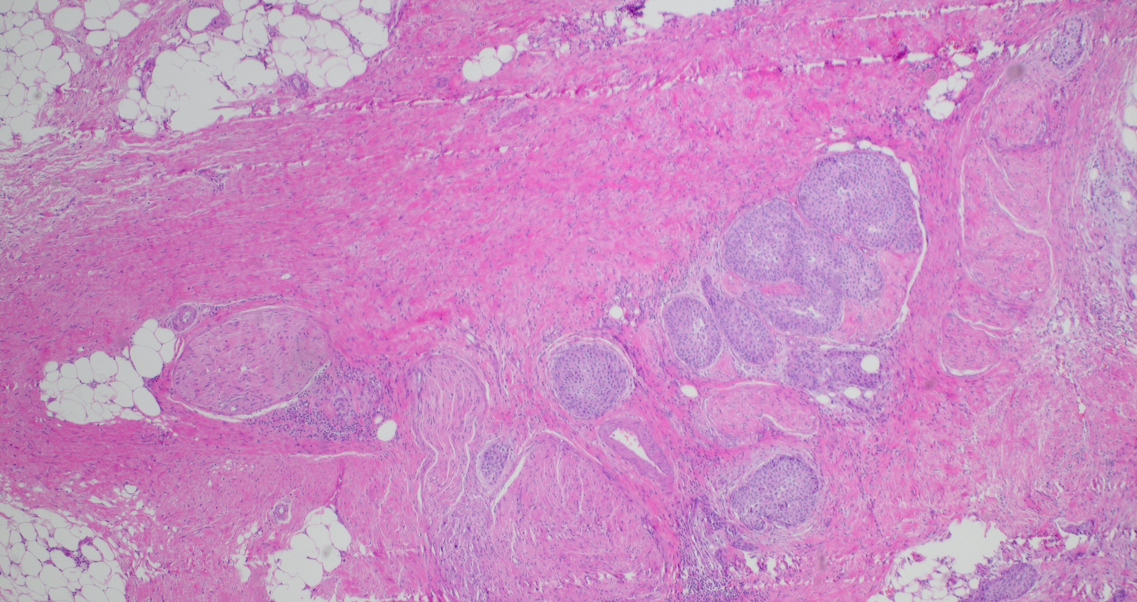

Slide 14
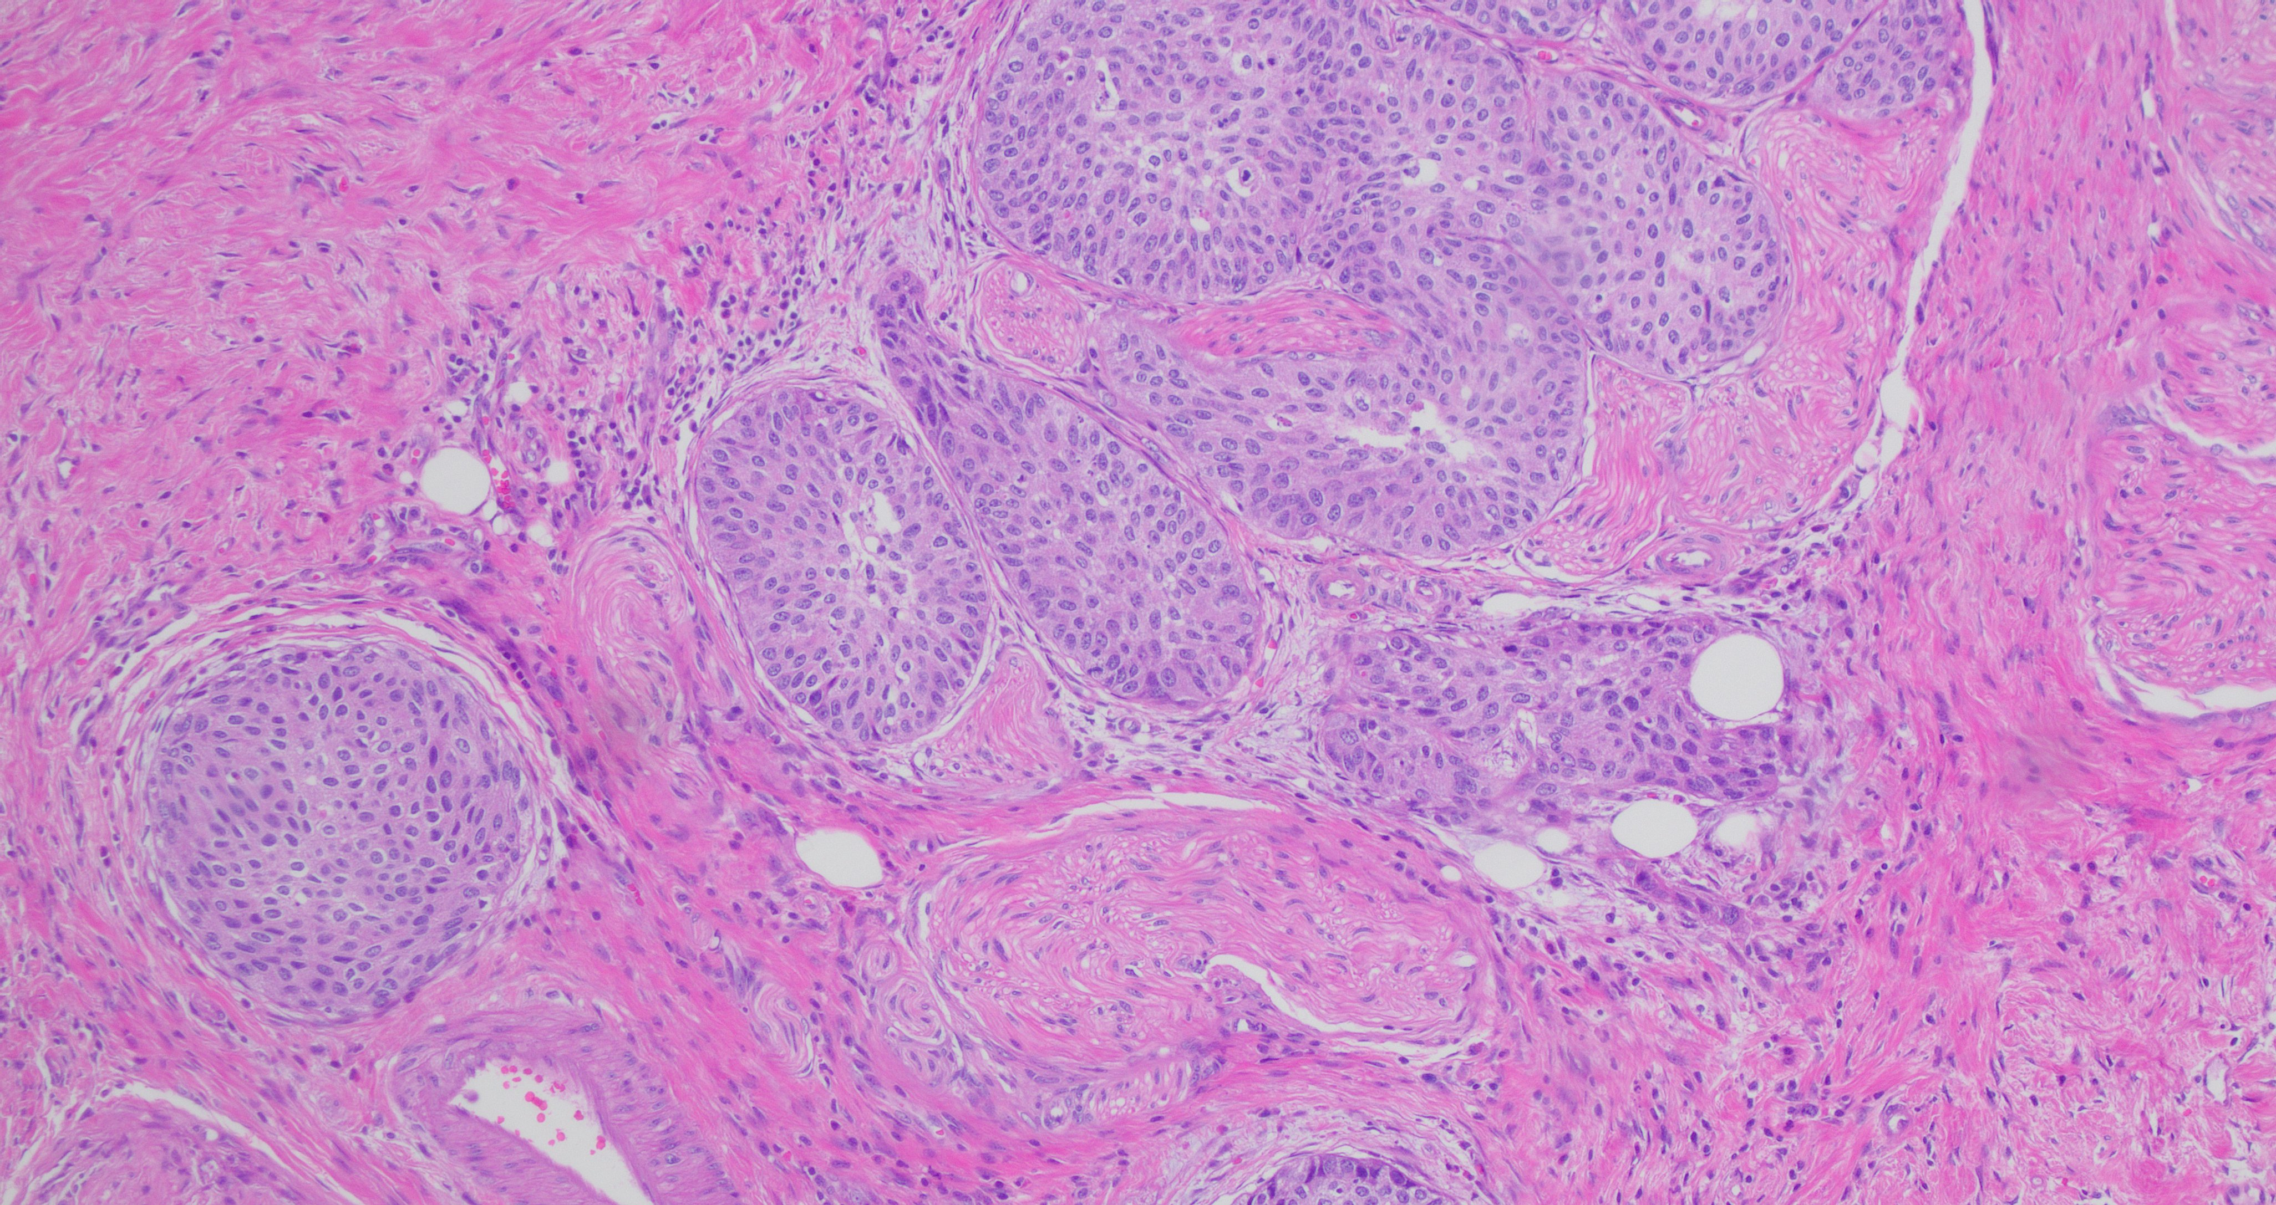
Large Nested Urothelial Carcinoma
(LNUC)

Slide 15
LNUC
Cytologically bland large irregularly infiltrating nests of urothelial cells
Variable stromal reaction, usually mild
May be mixed with other components including nested subtype
Usually high stage at diagnosis
Metastasis reported
Am J Surg Pathol 2011;35:1337–1342
Histopathology 2017, 71, 703–710
Am J Surg Pathol. 2023 Apr 1;47(4):461-468.
Mod Pathol. 2023 Dec;36(12):100333.
Notes:
Metastasis more in mixed cases, less in pure LNUC

Slide 16
LNUC
Differential Diagnosis
Noninvasive low-grade papillary urothelial carcinoma with inverted growth pattern
Von Brunn nests

Slide 17
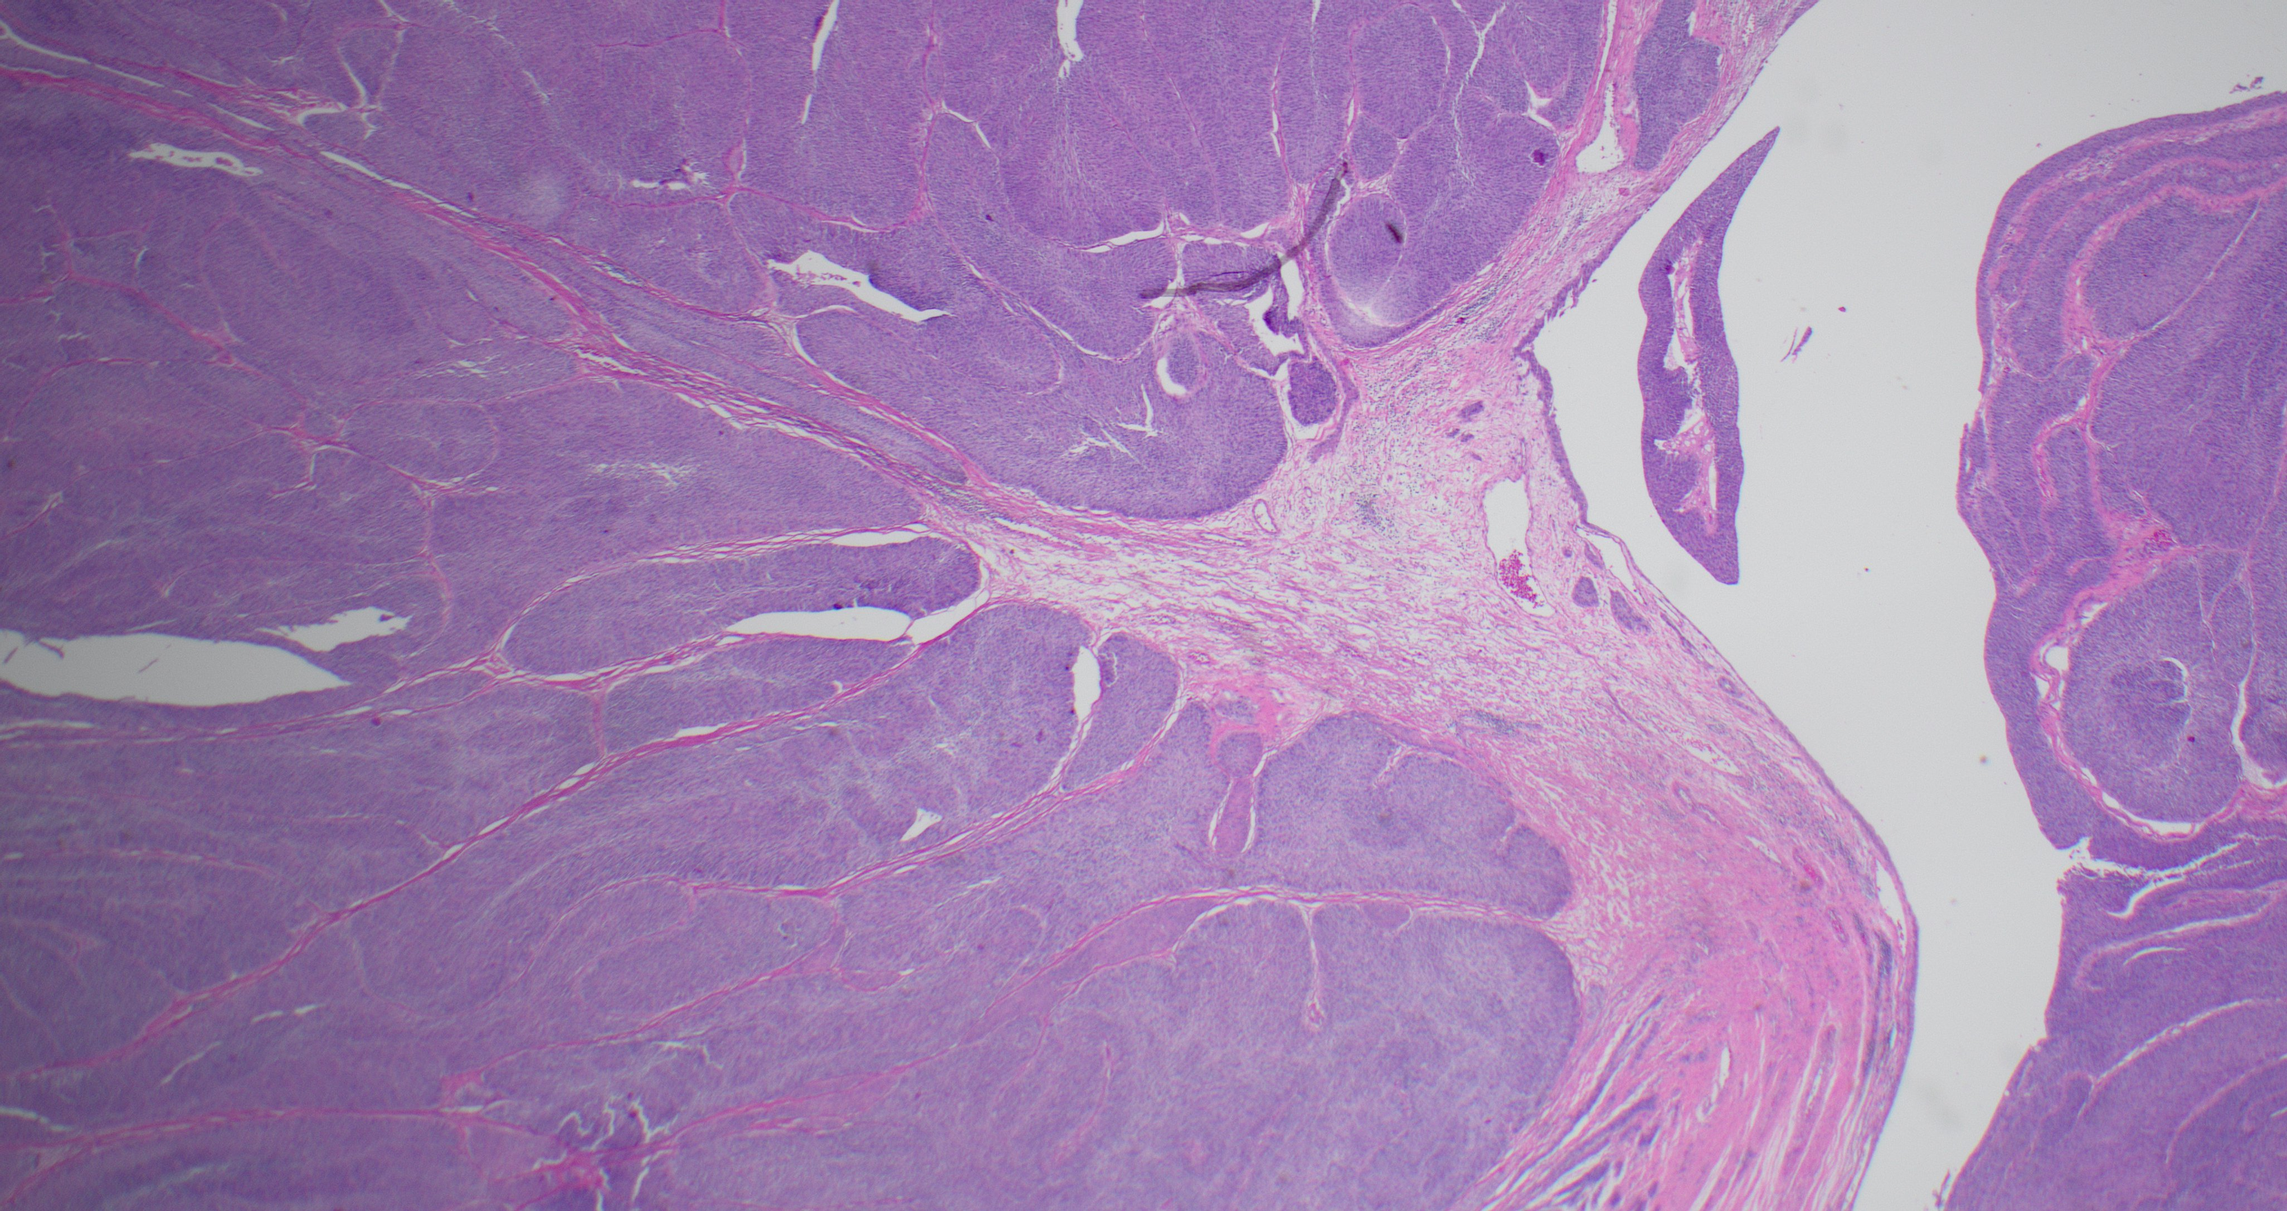

Slide 18
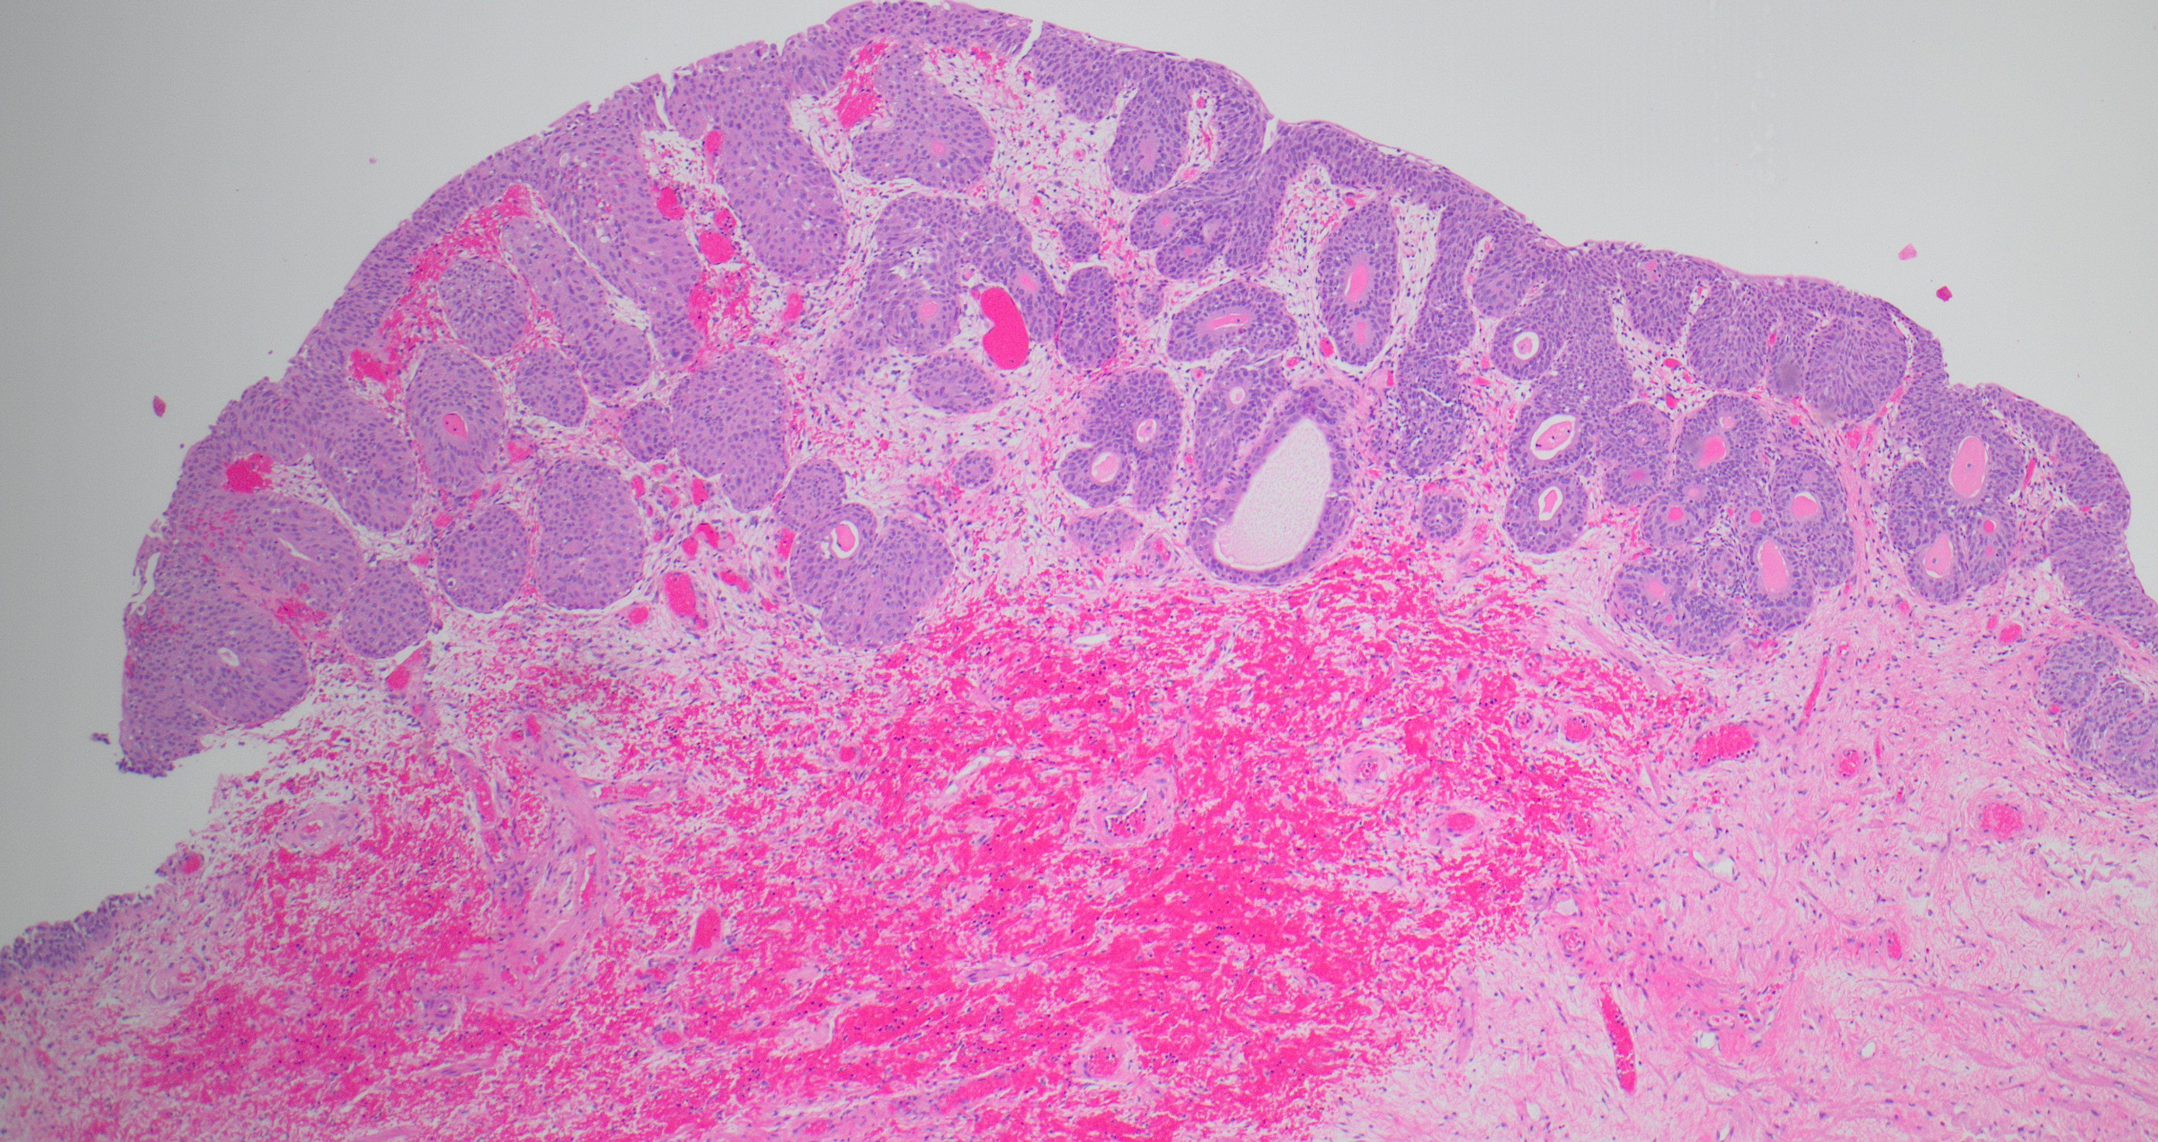

Slide 19
Molecular profile of LNUC
Activating mutations of FGFR3
Alterations in PIK3CA
Low TMB, MSS
Luminal papillary profile (RNA expression)
Cancers (Basel). 2020 Mar 24;12(3):763
Mod Pathol. 2023 Dec;36(12):100333
Cancers (Basel). 2023 Jun 13;15(12):3167.

Slide 20
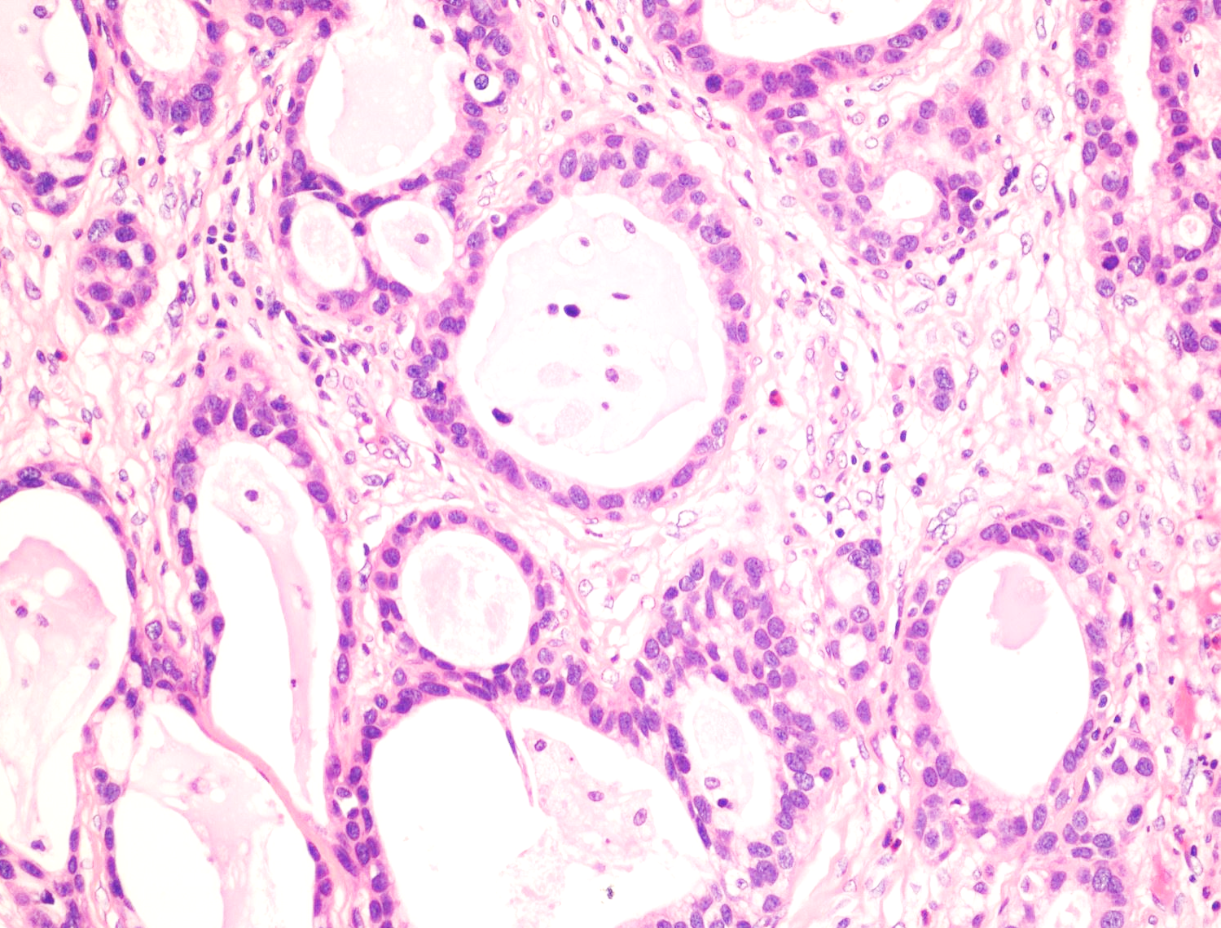
Tubular and microcystic urothelial carcinoma
Rare
Tubules and microcysts lined by bland cells
May mimic benign lesions like cystitis cystica
No/mild stromal reaction
Usually present at high stage
Histopathology. 2014 May;64(6):872-9
Diagn Pathol. 2023 Aug 19;18(1):94
Notes:
Aggressive because of late stage of presentation

Slide 21
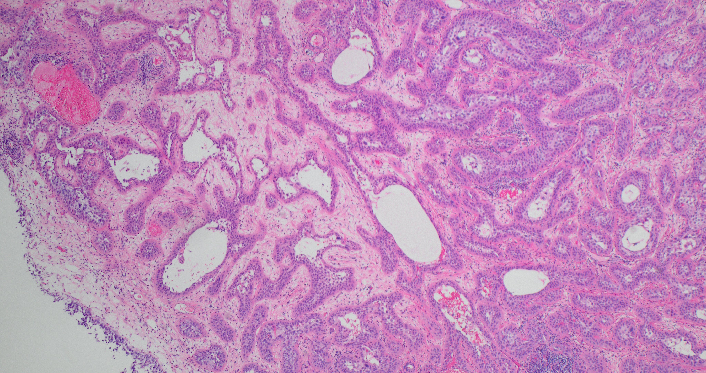

Slide 22
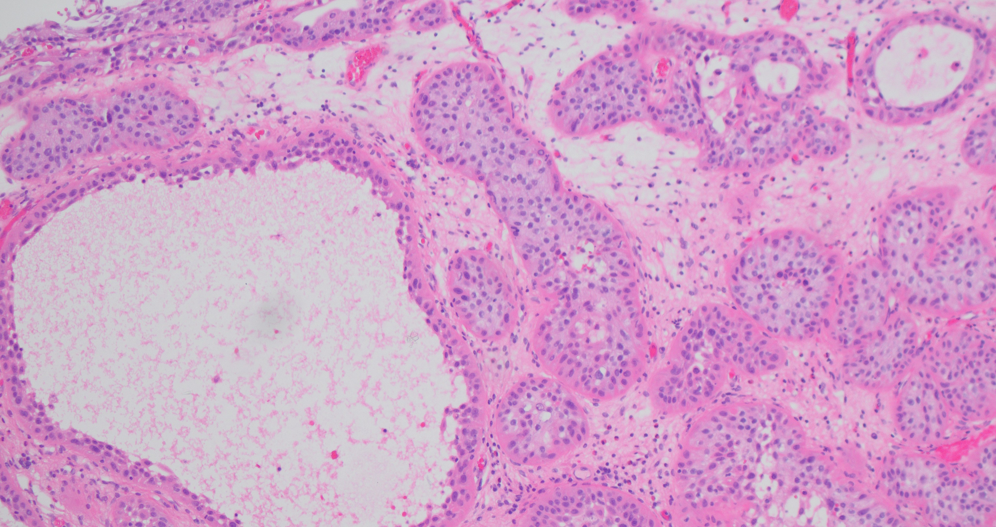
Often associated with nested subtype
Part of the morphological spectrum of nested?
Histopathology. 2014 May;64(6):872-9

Slide 23
Tubular and microcystic urothelial carcinoma
Molecular profile of this rare tumor has not been elucidated
Nested urothelial carcinoma is positive for luminal markers; but interestingly also stains for CK5/6 in a subset of cases
Am J Clin Pathol. 2021 Mar 15;155(4):588-596
Pathol Int. 2014 Aug;64(8):375-81
Notes:
Positive for CK 5 and CD44 (Mai et al)

Slide 24
Invasive urothelial carcinoma subtypes | Molecular features
Micropapillary | ERBB2 alterations; luminal phenotype; enrichment of PPARG & suppression of p63 target genes
2. Nested | Luminal markers on IHC (FOXA1, GATA-3 and,CK20); p53, JAK3 and CTNNB1 alterations
3. Large nested | FGFR3 mutations, luminal phenotype
4. Tubular and microcystic | N.A
Plasmacytoid | CDH1 truncating mutations; CDH1 promoter hypermethylation
Sarcomatoid | Mutations in p53, RB1 and PIK3CA; dysregulation of EMT network and overexpression of EMT markers and PDL-1; basal-squamous
7. Lipid-rich | N.A
8. Lymphoepithelioma-like | Basal-squamous phenotype; MSS; overexpress PDL-1
9. Clear cell (glycogen-rich)
Giant cell
11. Poorly differentiated
Notes:
Large nested separated from nested subtype. Why?
Tubular has been added to microcystic, but these patterns may represent an expanding spectrum of nested Uca
Concordance between the TUR and cystectomy specimen is poor in several subtypes, esp with micropapillary carcinomas. Maybe due to sampling, tumor heterogeneity, under recognition and underreporting
Any amount of the subtype should be reported. Even <10% micropap associated with poorer survival
Nested, large nested and microcystic usually present as >50%

Slide 25
Clinical significance of histologic subtypes
Am J Surg Pathol 2024;48:e11–e23
Notes:
The data is very variable regarding the clinical outcomes of subtypes and D/D, however analysis of the published literature generally shows the following

Slide 26
Clinical significance of histologic subtypes
Micropapillary
>25% micropapillary component associated with poorer prognosis compared to conventional Uro Ca
Higher instance of upstaging at cystectomy- early cystectomy and lymphadenectomy recommended
Plasmacytoid
Worse CSS than conventional Uro Ca
Higher chances of surgical margin positivity (upto 5x)
Increased risk of retroperitoneal recurrence
Am J Surg Pathol 2024;48:e11–e23
BJU Int 2023; 132: 170–180
Urol Oncol 2014; 32: 833-838
J Urol 2015; 193: 1129-1134
Notes:
All studies referred to is after adjusting for other factors like age,

Slide 27
pT1 substaging

Slide 28
pT1 substaging
pT1 are clinically heterogeneous
Extent of lamina propria invasion is associated with both tumor recurrence and progression
pT1 substaging recommended: WHO, AJCC, ISUP, GUPS, CAP
Not universally adopted: 38.9% of responders in an ISUP poll in 2022 did not substage pT1 tumors
Which method to implement?
Notes:
pT1 are a heterogeneous group of tumors with variable risk of tumor recurrence and progression
Progression risk can vary from 12-54% in clinical behavior and therefore there is a rationale for further substratifying these tumors

Slide 29
Methods
Histoanatomic
Quantitative
Using muscularis mucosae/Vascular plexus
Micrometric measurements
Microscopic field

Slide 30
Histoanatomic substaging using MM
pT1a: above
pT1b: below
pT1a: above
pT1b: into MM
pT1c: below
pT1a
pT1a
pT1b
pT1b
pT1c

Slide 31
Drawbacks of histoanatomic pT1 substaging
Difficulty in identifying MM
VP may vary with respect to MM
Difficulty in architectural orientation in TUR and cautery artifacts
Difficult to implement in re-resections, due to scarring, hyperplasia of the MM- not recommended

Slide 32
Quantitative
Micrometric measurements
Microscopic Fields
Depth of invasion
ALLICA
Largest contiguous focus
T microscopic/focal
less than 1hpf
T extensive/non-focal
≥ 1hpf
Single focus/ multiple foci
ALLICA
Notes:
Cut-off of 1.5 mm for depth of invasion
ALLICA: Cut off 2.3 mm (10X field) (Aggregate lineal length of invasive carcinoma)
Largest contiguous focus: cut off 3.6 mm or greater and >3 foci of invasive as statistically significant for predicting
progression

Slide 33
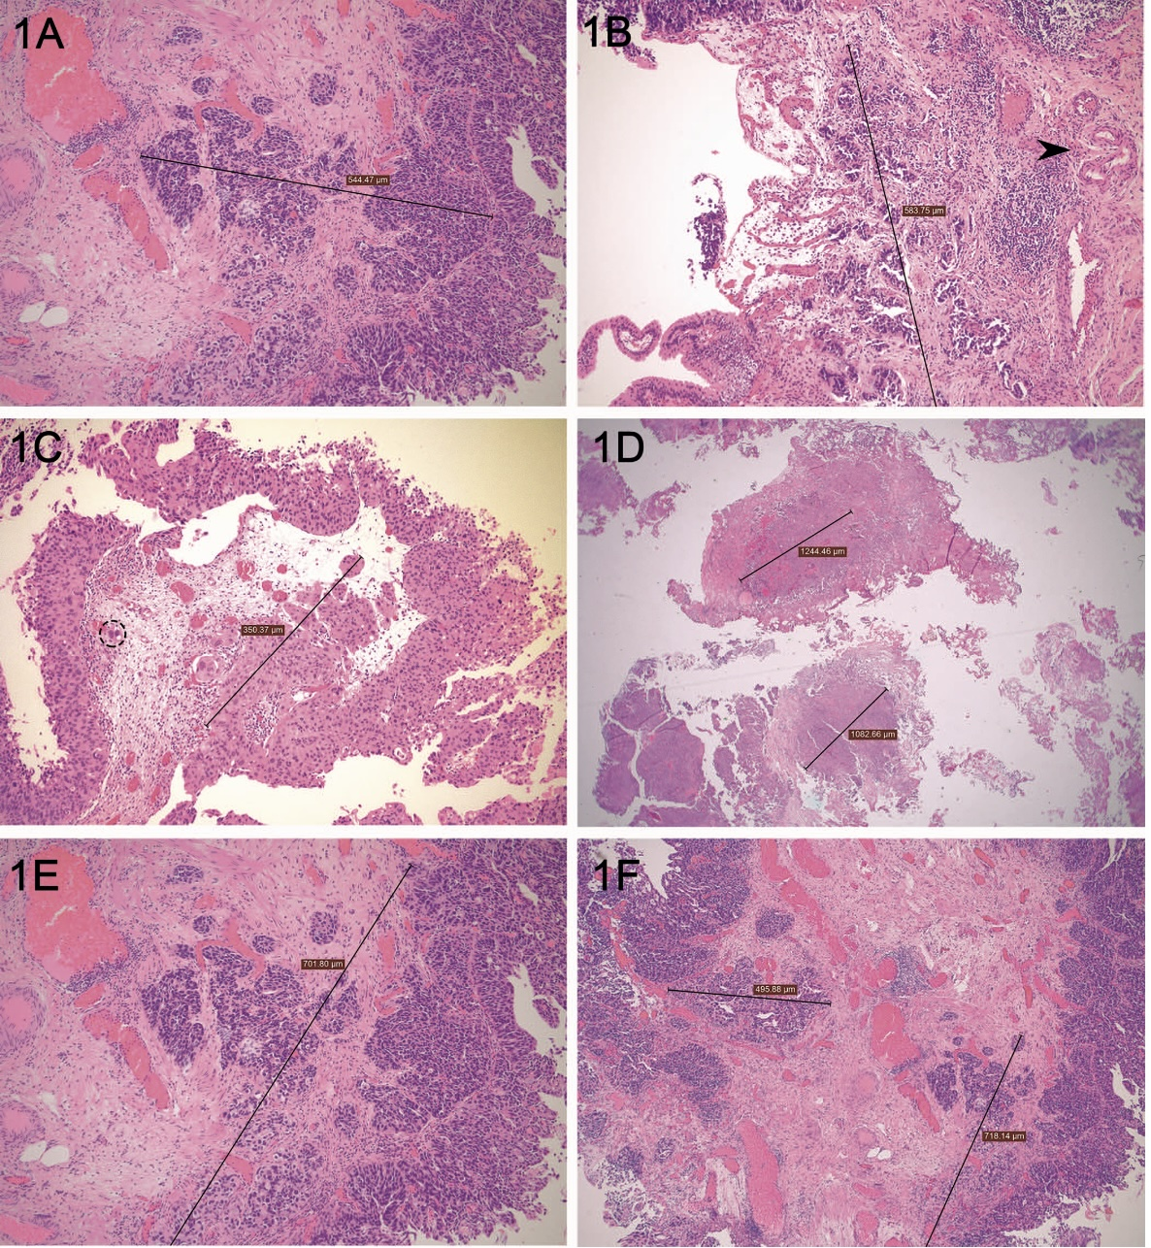
Largest contiguous
focus
Depth of invasion
ALLICA
Largest contiguous
focus
Largest contiguous
focus
ALLICA
Arch Pathol Lab Med. 2022;146:1131–1139

Slide 34
Which method to adopt?
Quantitative better than histoanatomical: more predictive of outcome (83% vs 50%)
Quantitative, without the use of an optical micrometer: practical and favored
No consensus; but should be consistent within a practice
Notes:
Head-head comparisons show quantitative better than histoanatomic
In the absence of well-designed prospective studies comparing the various methods there is no consensus

Slide 35
Molecular Subtyping of Urothelial
Carcinoma

Slide 36
Molecular subtyping
Numerous systems
Diverse with some overlap
Similar nomenclature, but not interchangeable
A consensus molecular classification was proposed to reconcile these differences and facilitate clinical application
Eur Urol. 2020 Apr;77(4):420-433.
Notes:
The systems are diverse in part due to the study design and statistical analysis. consensus classification system used 1750 MIBC transcriptomic profiles from 18 datasets to compare six molecular classification schemes and derive a consensus classification

Slide 37
Molecular classification systems
Highlights overlap, but also differences
The luminal subtype is more heterogenous that the basal-squamous subtypes
Notes:
This slide shows the overlap of the different subtyping schematic using the TCGA data sets. The tumors generally fall into luminal, basal/squamous and neuronal/neuroendocrine lbased, in schemata that recognize them. Molecular subtyping is different in the different systems because of the differences in the study design and analysis. Despite the overlap, there are also differences especially in the stromal and luminal infiltrated categories . There are various molecular subtyping systems which share some similarities/overlap but there are also highly relevant differences
Lund system does not include stromal and inflammatory signatures
While the p53 like in the MDA system is defined by the expression of stromal genes: but this is a heterogeneous group with luminal and basal subtypes when typed using other systems. Therefore using stromal genes may not be a good method to cklassify

Slide 38
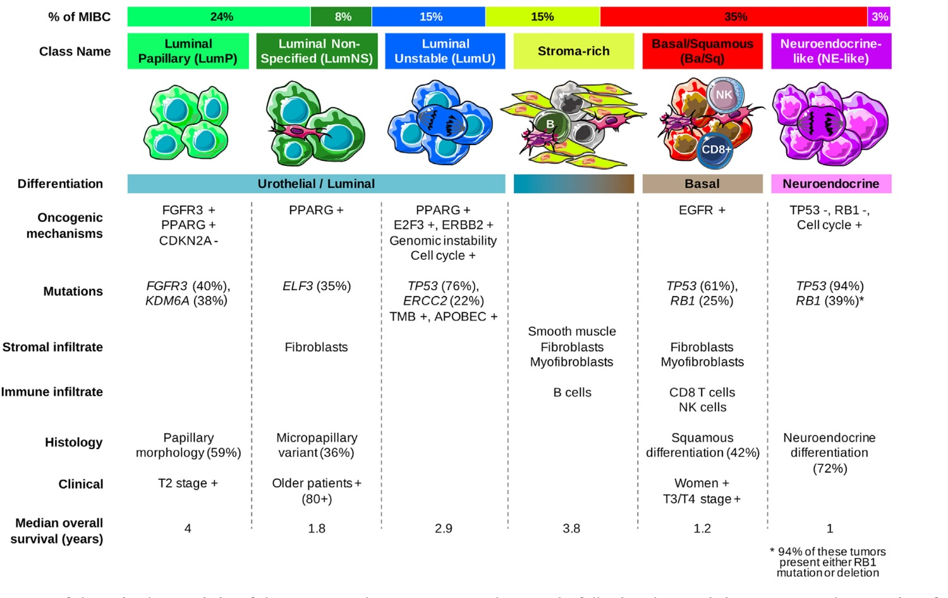
Consensus Classification
Eur Urol. 2020 Apr;77(4):420-433.
Notes:
Summary of the main characteristics of the consensus classes. From top to bottom, the following characteristics are presented: proportion of consensus classes in the 1750 tumor samples; consensus class names; schematic graphical representation of tumor cells and their microenvironments (immune cells, fibroblasts, and smooth muscle cells); differentiation-based color scale showing features associated with consensus classes, including a luminal-to-basal gradient and neuroendocrine differentiation; and a table displaying the dominant characteristics such as oncogenic mechanisms, mutations, stromal infiltrate, immune infiltrate, histology, clinical characteristics, and median overall survival.
Ba/Sq = basal/squamous; LumNS = luminal nonspecified; LumP = luminal papillary; LumU = luminal unstable; MIBC = muscle-invasive bladder cancer; NE = neuroendocrine; NK = natural killer

Slide 39
Molecular subtyping
Molecular subtypes AND tumor stage AND histology
Ta- luminal; T1- predominantly luminal, some basal-squamous
MIBC: basal-squamous, luminal and neuroendocrine-like
Nested, large nested, micropapillary- luminal; small cell- neuroendocrine
Molecular heterogeneity
Intratumoral heterogeneity: most pronounced in tumors with subtype histology
Between primary and recurrences/metastasis
Notes:
CIS is also mostly luminal, limited studies
T1 cancers are also diverse in cell cycle activity and expression of immune signatures
Intratumoral heterogeneity is less within homogeneous areas of the tumors; more studies needed
More pronounced in basisquamous with respect to recurrence and metsatasis
Tumors that do not necessarily fall into one category are often classified differently by different subtyping systems- important to keep in mind while developing a test to guide therapy; also molecular subtypes assigned by different subtypes are not interchangeable
Luminal bladder cancers are biologically diverse
Both because of microenvironment and cancer cell characteristics particularly FGFR3 signaling and RB1 inactivation

Slide 40
Potential Value of Molecular Subtyping
Identifying T1 tumors that recur or progress after BCG therapy, who may benefit with early cystectomy
Accurate grading of pTa tumors
Tailoring therapies: Potential role as predictive biomarkers of therapy response
Notes:
Tumors with genomically unstable and UroB molecular subtypes in the Lund system have higher rates of progression
High cell cycle activity and low immune signatures are associated with rapid rate of recurrences
potential role of the use of cell cycle activity and immune signatures in identifying those with high risk of recurrence and progression
Neoadjuvant platinum-based therapy modestly improves survival in patients with non luminal subtypes (decipher assay)
Genomicaly unstable subtype in Lund system benefits disproportionally to platinum-based therapy
Genomicaly unstable subtype in Lund system benefits disproportionally to platinum-based therapy; These correspond to the luminal unstable of the Consensus system which show ERCC2 gene mutations
Molecular subtypes are less valuable in predicting response to immune checkpoint inhibitor therapy; markes of immune activity better (TMB, infiltration by cytotoxic T lymphocytes and PDL-1 expression)

Slide 41
Current status of Molecular Subtypes in Clinical Management
NOT READY FOR PRIMETIME
Insufficient data to support the use of molecular subtyping in guiding bladder cancer management
What assay and which system should be used to assign molecular subtypes
Notes:
Despite all these potential benefits

Slide 42
Summary
The 5th edition of WHO includes changes in terminologies and tumor subtypes
The search continues for refining the grading system to better reflect prognosis
pT1 substaging- how?- All up to you
Molecular subtyping has exciting potential applications; adoption of a consensus molecular classification would be a great step in the right direction

